Slide 1
Review: PI 26 and the Mojaloop Roadmap
Paul Makin
14th April 2025

Slide 2
PI 26 Review

Slide 3
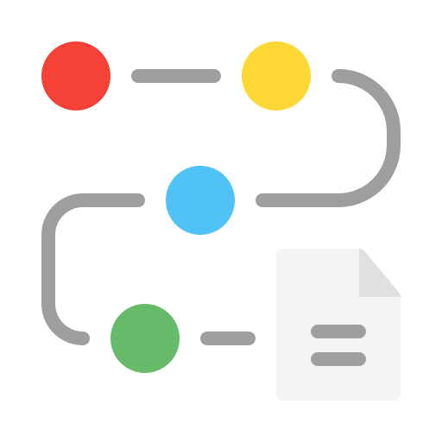
Recent Successes: Mojaloop V17
Major advances in functionality:
FX, Interscheme, ISO 20022 messaging
Significant improvements in quality
SBOMs, hardening releases, identifying deprecated libraries, authenticating provenance of artefacts
Performance now at industry-standard
A lot more to come
Now have a comprehensive approach to DFSP onboarding
3

Slide 4
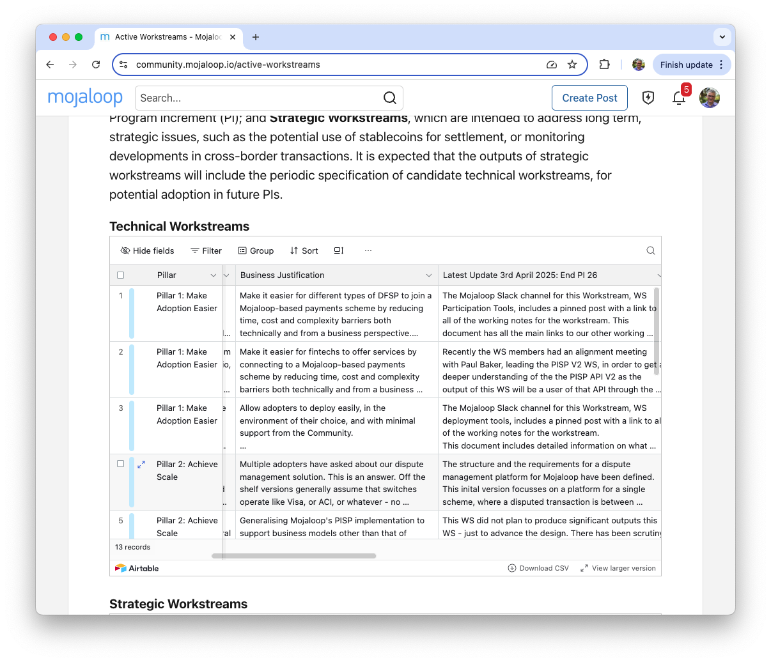
Workstream Updates https://community.mojaloop.io/active-workstreams
Updated monthly
Details:
Status
Description
Business Justification
Latest Update
Objectives
Acceptance Criteria
Meeting details
Etc.

Slide 5
PI 26 Workstreams: Pillar 1, Make Adoption Easier
Workstream Name | Achievements | PI 27?
Participation Tools | Different tools for different types of DFSP; DFSP vs Tool “Feature Matrix” drafted; developing enhancements to the “shared” element of the various tools. Also conducting a DFSP survey to validate assumptions. | Y
Participation Tools for Fintechs | Detailed coordination with the PISP 2.0 workstream, of which this is a consumer. WS now working to define an Open Banking API for onboarding fintechs etc. | Y
Deployment Tools | Multiple deployment tools available; developed a feature matrix to map the tools to the types/purposes of a deployment, supporting the various different levels of deployment requirement in terms of SLA reliability, redundancy and performance. Also working to properly document IaC. Next, a gap analysis to identify further work required. | Y

Slide 6
PI 26 Workstreams: Pillar 2, Achieve Scale
Workstream Name | Achievements | PI 27?
Dispute Management | The structure and the requirements for a dispute management platform for Mojaloop have been defined, focussing initially on a platform for a single scheme. Multiple candidates have been reviewed. Closest match is the platform developed by Rswitch in Rwanda, meets 80%+ of requirements. Decision needed soon, leading to development, leading to a pilot by end PI 27. | Y
PISP V2.0 Implementation | Refinement of the design completed, including review by the DA and others. New features focus on bulk payments. Development of this expected to be completed in PI 27. Further extension is anticipated, around notifications and its potential use for FX. | Y

Slide 7
PI 26 Workstreams: Pillar 2, Achieve Scale
Workstream Name | Achievements | PI 27?
LEI Addressing | The WS has gone through a few iterations of the work stream definition, tightening its focus clearly on the definition of an addressing framework for cross-border merchant payments based on the LEI. In a second phase, the pilot will be extended to support LEI registration for small merchants. A draft process is in place. Pilot by end PI 27. | Y
Refactor Bulk Payments | Not Yet Begun | Y
FX Refinement | Not Yet Begun | Y

Slide 8
PI 26 Workstreams: Pillar 3, Connect to Other Systems
Workstream Name | Achievements | PI 27?
ISO 20022 Refinement | The Market Practice document has been refined; a new draft is out for review. There are still a few gaps, but these are felt to be minor. Once it is finalised, the document will be registered with the ISO organization so that they are publicly available to anybody who wants to know how Mojaloop systems in general manage ISO 20022 messages. The MPD is now available to the wider Community for their review, at https://docs.mojaloop.io/product/features/Iso20022/MarketPracticeDocument.html | Y

Slide 9
PI 26 Workstreams: Foundation - Quality Product
Workstream Name | Achievement | PI 27?
Mojaloop Evolution | A prototype of TigerBeetle integration for transaction processing was shown at the Convening, accompanied by an overview of how we want to represent in accounting terms what's happening inside a Mojaloop system. The WS is also looking at the settlement side of things, including looking at a potential alternative strategy which hopefully will cut down the amount of work that the core needs to do in order to to retain settlement information. | Y
Performance Optimisation | The WS members have defined the test cases and the overall plan: defining the scenarios we want to test, and which will be used to demonstrate performance. The test lab is expected to be sponsored by AWS and they will contribute to the white paper as well, along with Infitex. The aim is to release a white paper around the middle of the next PI. | Y

Slide 10
PI 26 Workstreams: Foundation - Quality Product
Workstream Name | Achievement | PI 27?
Platform Quality and Security | The target for this PI was to strengthen the module release process and overall code base, focusing on issues like licensing, security, and efficiency. Key goals included ensuring proper license headers in source files, better code protection, and review processes, and using tools like GitHub’s Dependabot to address security vulnerabilities. The Mojaloop v17 release addressed these issues and also introduced signed Helm charts for Kubernetes deployment, improving artefact provenance. Another ongoing initiative is self-assessing the security processes against the OpenSSF standards, aiming to close any gaps. | Y
Core and Releases | Mojaloop v17 has been released. It has been extensively tested, including the new features such as ISO 20022 messaging and FX. The release notes have been made available on the website and Community Central, accompanied by a Product-oriented blogpost that was also placed on LinkedIn. Work on V17.1 continues. | Y

Slide 11
PI 26 Challenges
Slow start to some PI 26 workstreams
Limited contribution capacity
Shortage of experienced WS leads
Need to expand range of contributors
Need to improve Product Documentation to assist adopters
Less “what”, more “how”
Product Council needs rethinking
More future thinking, leading to roadmap enhancements
WS sessions reduced by 50%
More accessible sessions for SIs and central bankers
3

Slide 12
Roadmap

Slide 13
PI 27 Top Priorities
Tigerbeetle integration
Significant performance improvements
New settlement capabilities
Streamlined Mojaloop integration
Better, unified deployment tools
Properly documented
Better, more appropriate participation tools
Matched to the needs of participants
3

Slide 14
PI 27 Workstreams
It is proposed that all PI 26 workstreams should carry over to PI 27
With two candidate additions:
Moses Kipchirchir of KPMG East Africa has proposed the creation of a QA Assessment Framework, which can be used to allow adopters to ascertain that their deployed service meets the standards for quality, security and reliability across a range of service areas
The MLF has been discussing with SWIFT the potential for a SWIFT/Mojaloop interconnect. We propose a workstream to develop a PoC, in collaboration with SWIFT.
These will be reviewed at an upcoming Product Council meeting.

Slide 15
Workstream Suggestions
Requirements may be submitted via any of the following mechanisms:
They may be raised at any Product Council meeting
The Mojaloop Slack channel at #product-council
By email to the Product Director pmakin@Mojaloop.io
By raising an issue on the Product Council repo, at https://github.com/mojaloop/product-council/issues
Requirements will then be discussed at the following Product Council meeting.

Slide 16
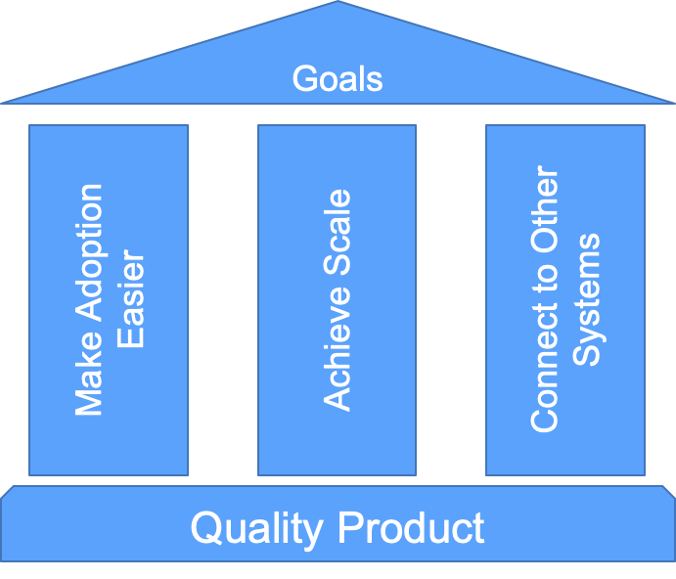
Pillars

Slide 17
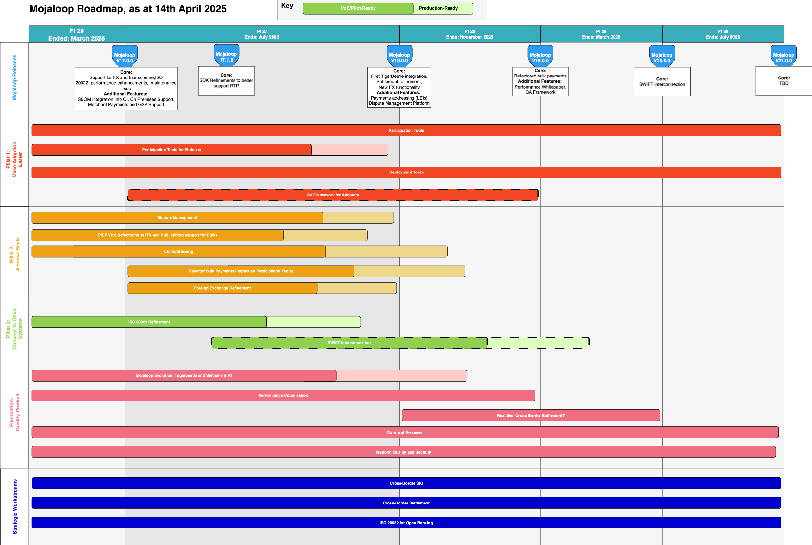
Roadmap

Slide 18
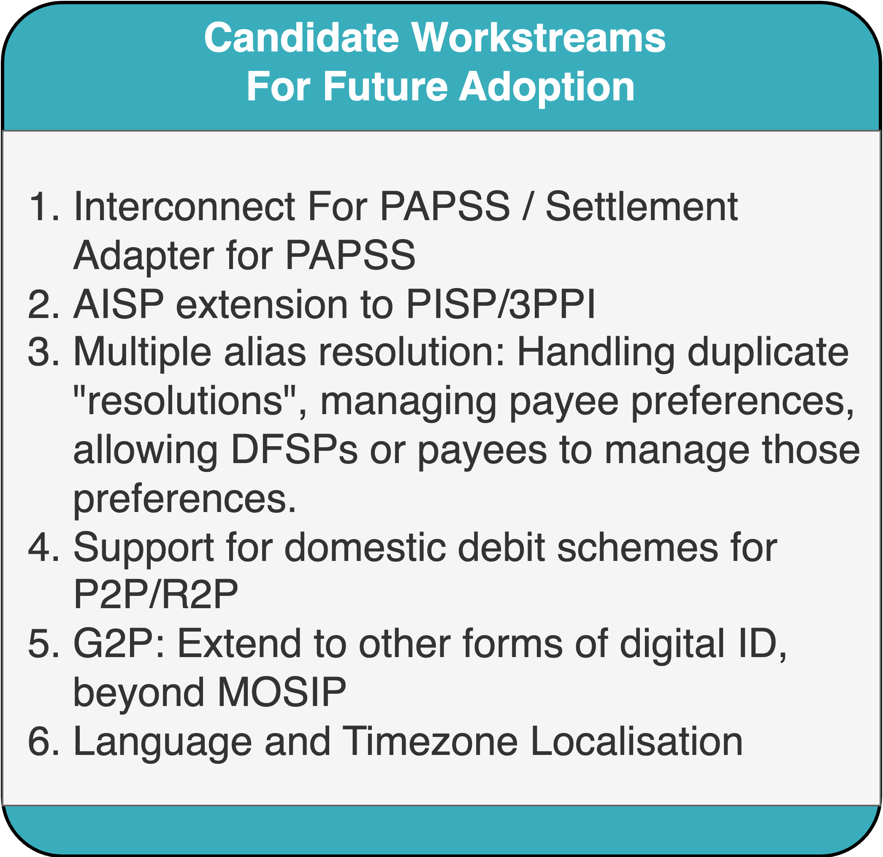
Workstream Backlog

Slide 19
But….
Mojaloop is approaching the point of core functionality completeness (though a lot of refinement and documentation is still needed, particularly in the areas of interconnectivity, cross border transactions, and settlement)
That’s not to say that development is in any way complete; but the principal objectives for PI 27 (TigerBeetle, better deployment tools, better onboarding tools) suggest an evolution in focus
And so the Pillars may have served their purpose
Also, there’s a need to refine the long term roadmap; this is best done in collaboration with industry leaders and members of the Mojaloop Community

Slide 20
Product Council
All of this might imply there’s a need to reform Product Council, and the way it operates
I’ll be laying out some proposals in this afternoon’s session, titled “Reshaping Product Council”

Slide 21
Thank you
Questions?

